Slide 1
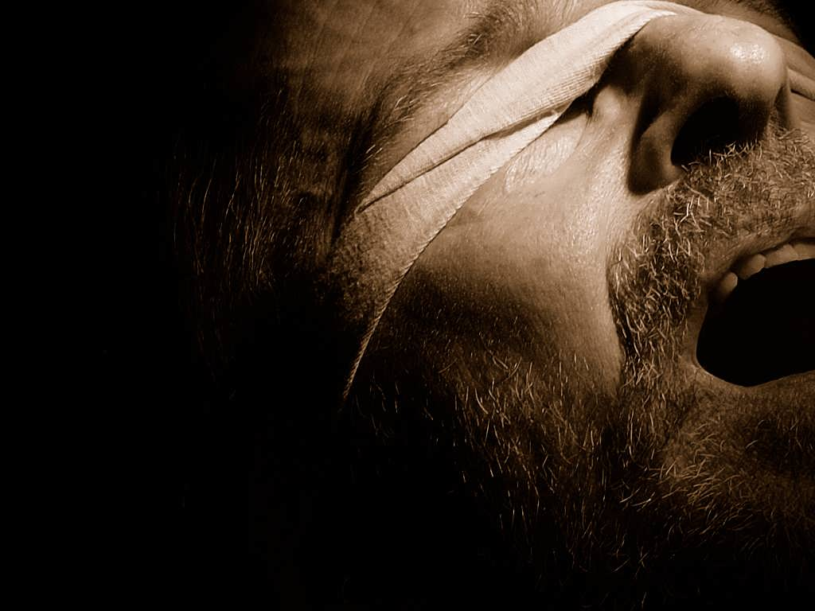




the bondage of
Cults and Isms
the 4 Unusual “U’s”
unity
A free CD of this message will be available following the service
It will also be available for podcast later this week at calvaryokc.com

Slide 2
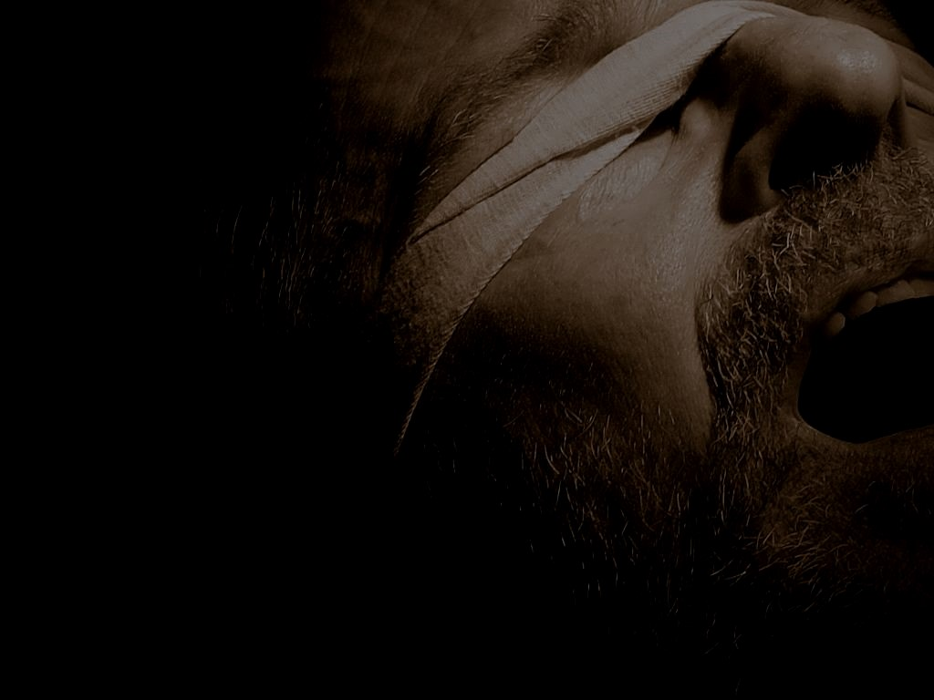
Unification Church (Moonies)
Unity Church
unity
Unitarianism
Universalism
the bondage of the Unusual 4 “U’s”

Slide 3

Unification Church (Moonies)
the bondage of the Unusual 4 “U’s”

Slide 4
“The Holy Spirit Association for the Unification of World Christianity” in 1954
“The Family Federation for World Peace and Unification”
the bondage of the Unusual 4 “U’s”

Slide 5
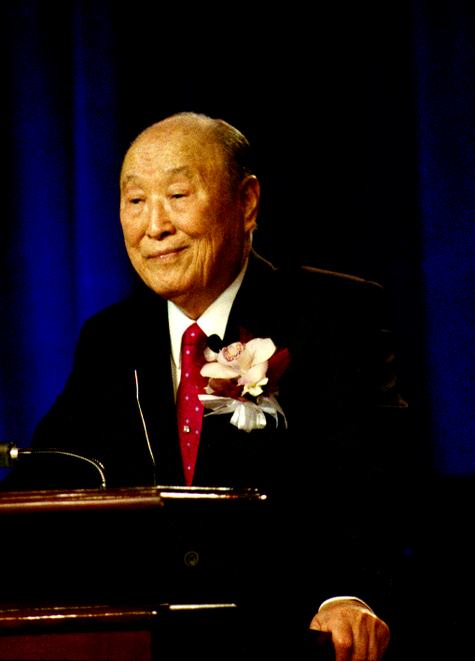
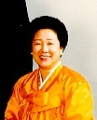
Sun Myung Moon (1920-2012)
He is the Messiah
The “True Parents”
Hak Ja Han (b. 1943)
She is the Holy Spirit
the bondage of the Unusual 4 “U’s”

Slide 6
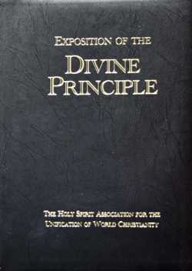
the bondage of the Unusual 4 “U’s”

Slide 7

Matt. 24:27 ~ For as the lightning comes from the east and flashes to the west, so also will the coming of the Son of Man be.
the bondage of the Unusual 4 “U’s”

Slide 8
the bondage of the Unusual 4 “U’s”

Slide 9
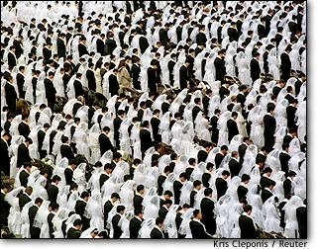
“Blessing Ceremony” Nov., 1997, 30,000 people
the bondage of the Unusual 4 “U’s”

Slide 10
the bondage of the Unusual 4 “U’s”

Slide 11
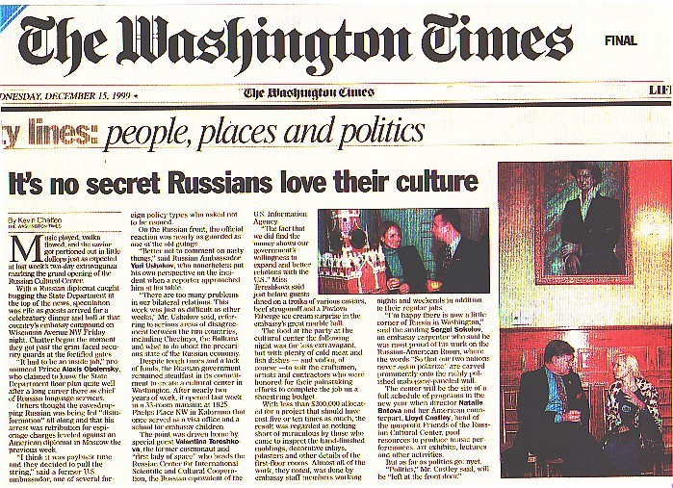
the bondage of the Unusual 4 “U’s”

Slide 12
the bondage of the Unusual 4 “U’s”

Slide 13
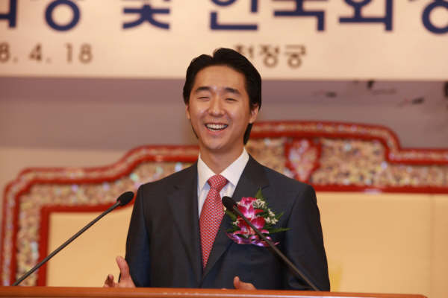
Hyung Jim Moon
the bondage of the Unusual 4 “U’s”

Slide 14
the bondage of the Unusual 4 “U’s”

Slide 15
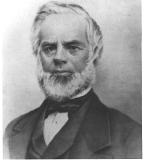
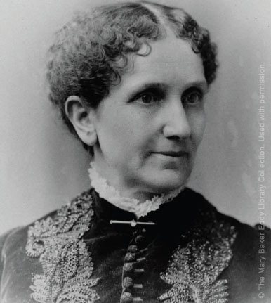
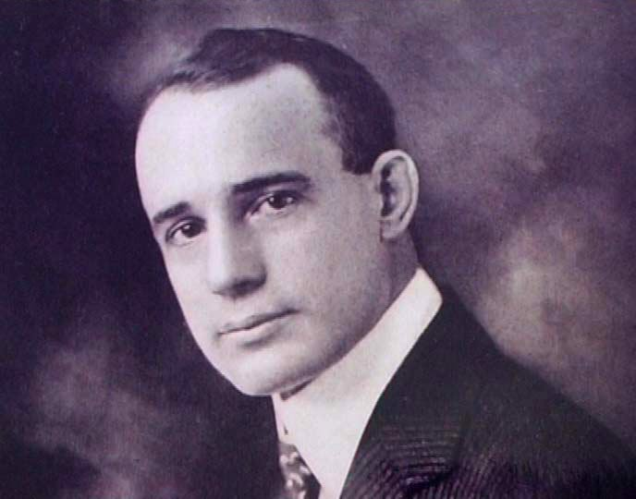
“New Thought”
Influenced Mary Baker Eddy and Napoleon Hill
Phineas P. Quimby
1802-1866
the bondage of the Unusual 4 “U’s”

Slide 16
Chief tenets:
Infinite Intelligence or God is omni-potent and omnipresent
Spirit is the ultimate reality
True human self-hood is divine
Divinely attuned thought is a positive force for good
All disease is mental in origin
Right thinking has a healing effect
the bondage of the Unusual 4 “U’s”

Slide 17
the bondage of the Unusual 4 “U’s”

Slide 18
Unity Church
unity
the bondage of the Unusual 4 “U’s”

Slide 19
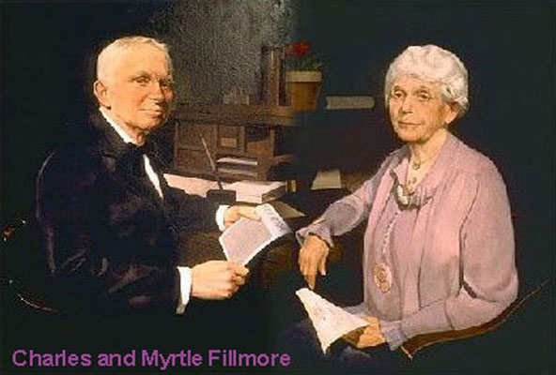
Charles and Myrtle Fillmore
the bondage of the Unusual 4 “U’s”

Slide 20
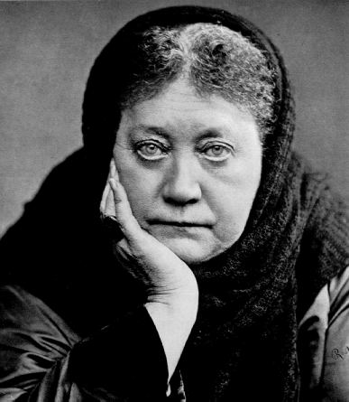
Influenced by New Thought
Mary Baker Eddy (Christian Science) and Helena Blavatsky (Theosophical Society)
the bondage of the Unusual 4 “U’s”

Slide 21
Basic Beliefs (www.unity.org):
God: God is Spirit, the loving source of all that is. God is the one power, all good, everywhere present, all wisdom. God is divine energy, continually creating.
the bondage of the Unusual 4 “U’s”

Slide 22
Basic Beliefs:
Jesus: We believe that Jesus expressed his divine potential and sought to show humankind how to express ours as well. We see Jesus as a master teacher of universal truths and as our Way Shower.
the bondage of the Unusual 4 “U’s”

Slide 23
Basic Beliefs:
The Bible: Unity founders Charles and Myrtle Fillmore studied the Bible as history and allegory and interpreted it as a metaphysical representation of humankind's evolutionary journey toward spiritual awakening.
the bondage of the Unusual 4 “U’s”

Slide 24
Basic Beliefs:
Man: We are each individual, eternal expressions of God. Our essential nature is divine and therefore inherently good.
the bondage of the Unusual 4 “U’s”

Slide 25
Basic Beliefs:
Prayer: Affirmative prayer is the highest form of creative thought. It includes the release of counterproductive, negative thoughts, as well as holding in mind statements of spiritual truth.
the bondage of the Unusual 4 “U’s”

Slide 26
Miscellaneous:
Heaven is not a place, but a state of consciousness; we create our own heaven and hell here and now.
We all have an innate capacity to know God through direct experience.
Prayer works.
the bondage of the Unusual 4 “U’s”

Slide 27
Miscellaneous:
The “Christ” is that part of God that is in every person. There is a spark of divinity within all people, just as there was in Jesus.
We are here to set a positive example and be a role model for others.
the bondage of the Unusual 4 “U’s”

Slide 28

Miscellaneous:
We are here to make the world a better place.
the bondage of the Unusual 4 “U’s”

Slide 29
Notable adherents: Betty White, Eleanor Powell, Wally Amos, Barbara Billingsley, Patricia Neal, Esther Williams and Maya Angelou
the bondage of the Unusual 4 “U’s”

Slide 30
the bondage of the Unusual 4 “U’s”

Slide 31
Unitarian Universalist Church
the bondage of the Unusual 4 “U’s”

Slide 32
the bondage of the Unusual 4 “U’s”

Slide 33
Principles:
Rev. Barbara Wells ten Hove ~ “The Principles are not dogma or doctrine, but rather a guide for those of us who choose to join and participate in Unitarian Universalist religious communities.”
the bondage of the Unusual 4 “U’s”

Slide 34
Principles:
1st Principle: The inherent worth and dignity of every person;
2nd Principle: Justice, equity and compassion in human relations;
3rd Principle: Acceptance of one another and encouragement to spiritual growth in our congregations;
the bondage of the Unusual 4 “U’s”

Slide 35
Principles:
4th Principle: A free and responsible search for truth and meaning;
5th Principle: The right of conscience and the use of the democratic process within our congregations and in society at large;
the bondage of the Unusual 4 “U’s”

Slide 36
Principles:
6th Principle: The goal of world community with peace, liberty, and justice for all;
7th Principle: Respect for the interdependent web of all existence of which we are a part.
the bondage of the Unusual 4 “U’s”

Slide 37
the bondage of the Unusual 4 “U’s”

Slide 38
This week’s activities:
Studying the works of Ralph Waldo Emerson
Meditations in the Buddhist tradition
Presentation on “Watts & Lumens: Saving Money & Earth with Replacement Lighting”
the bondage of the Unusual 4 “U’s”

Slide 39
The theology of individual Unitarian Universalists ranges widely, including Humanism, Atheism, Agnosticism, Pantheism, Deism, Christianity, Judaism, Neopaganism, Hinduism, Buddhism, and many more
the bondage of the Unusual 4 “U’s”

Slide 40
the bondage of the Unusual 4 “U’s”

Slide 41
Universalism
the bondage of the Unusual 4 “U’s”

Slide 42
Universal reconciliation ~ the belief that all humans and (in some beliefs) fallen angels will be some day be reconciled to God by Christ’s atonement
3 types: Evangelical Universalism, Liberal Universalism and Charismatic Universalism
the bondage of the Unusual 4 “U’s”

Slide 43
Evangelical Universalism:
Trinitarian Universalism or Victorious Gospel (mainly in Europe)
Syllogism:
God is all-sovereign
God is all-loving
Therefore, there is no eternal torment
the bondage of the Unusual 4 “U’s”

Slide 44
Rev. 14:11 ~ And the smoke of their torment ascends forever and ever;
and they have no rest day or night, who worship the beast and his image, and whoever receives the mark of his name.
John R. W. Stott ~ “The fire itself is termed ‘eternal’ and ‘unquenchable’, but it would be very odd if what is thrown into it proves indestructible. Our expectation would be the opposite: it would be consumed forever, not tormented forever. Hence it is the smoke (evidence that the fire has done its work) which ‘rises for ever and ever.’”
the bondage of the Unusual 4 “U’s”

Slide 45

the bondage of the Unusual 4 “U’s”

Slide 46
the bondage of the Unusual 4 “U’s”

Slide 47
Liberal Universalism:
Mainly mainline denominations influenced by New Thought and other New Age philosophies
the bondage of the Unusual 4 “U’s”

Slide 48
the bondage of the Unusual 4 “U’s”

Slide 49
Charismatic Universalism:
Mystical form of post-millennialism
A type of the “Manifested Sons of God”
Prefer the catch-all term “reconciliation”
the bondage of the Unusual 4 “U’s”

Slide 50
the bondage of the Unusual 4 “U’s”

Slide 51
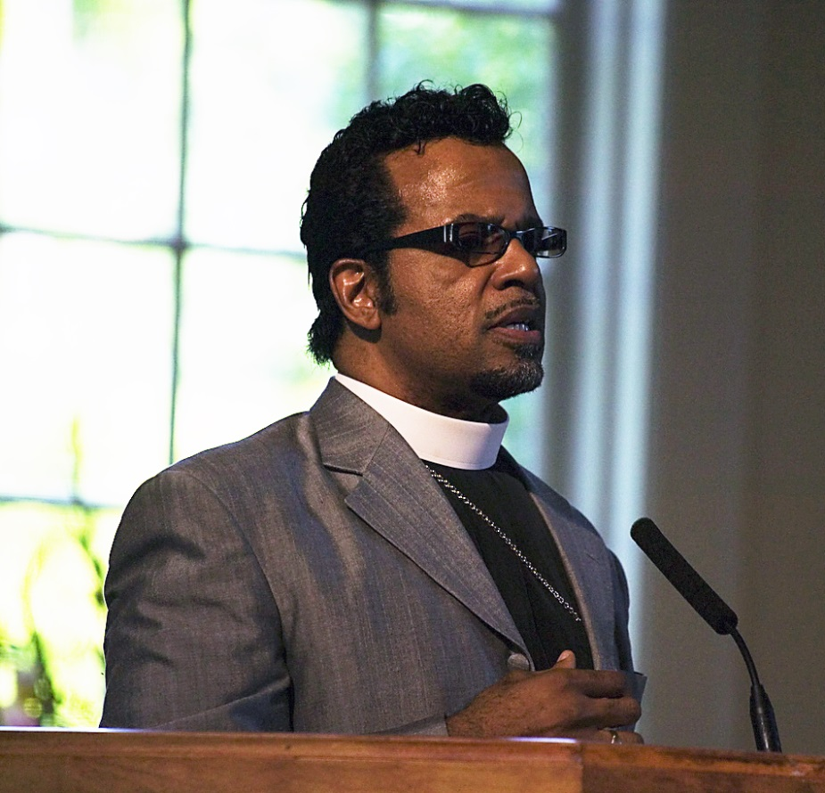
Higher Dimensions Evangelistic Center
Began teaching his “Gospel of Inclusion” early 2000s
Declared heresy in 2004
Carlton Pearson
the bondage of the Unusual 4 “U’s”

Slide 52
the bondage of the Unusual 4 “U’s”

